Slide 1

HOW THINGS ARE DONE
PRE-QUARTER ASSIGNMENT
ITGM 220/ PROFESSOR CHIU
GABRIEL

Slide 2

ME MYSELF
GABRIEL LAM
AKA GABRIEL MATALEO
I am a multimedia experience designer who brings ideas to reality. Currently working at Nam Fung Group fulltime to assist “the Mills” to build experiential retail experience
I also partner with small business, startups and NGOs across Hong Kong to build their brands and promote their aims
Feel free to follow me on Instagram @mataleo_gml
GABRIEL

Slide 3
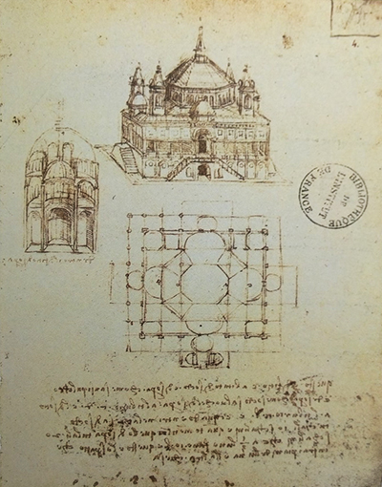
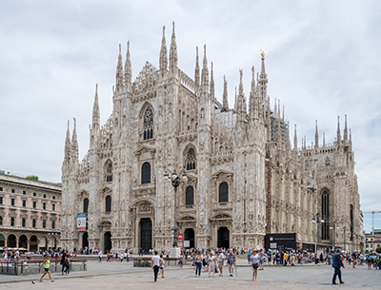
HOW THINGS ARE DONE
THE PAST
Drawing has been a part of the design process from the very beginning, from Leonardo da Vinci to architects constructing a modern skyscraper, drawings are an essential process for construction workers to communicate with the designer and understand how and what to do.
GABRIEL

Slide 4
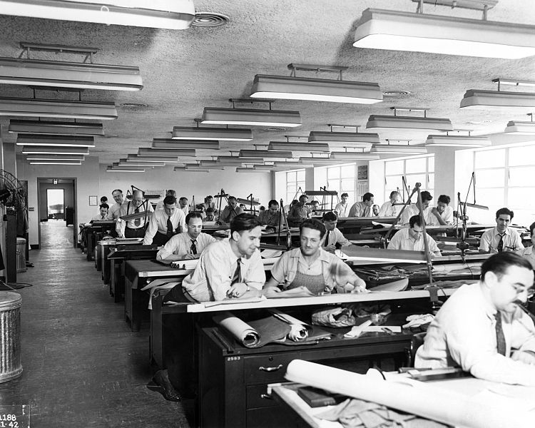
HOW THINGS ARE DONE
THE 30-40s
Starting from 1930s due to the skyscraper boom after the opening of the Empire State Building, more and more people are dedicated in these large drafting room to handle every aspect and detail of the creation of the building.
GABRIEL

Slide 5
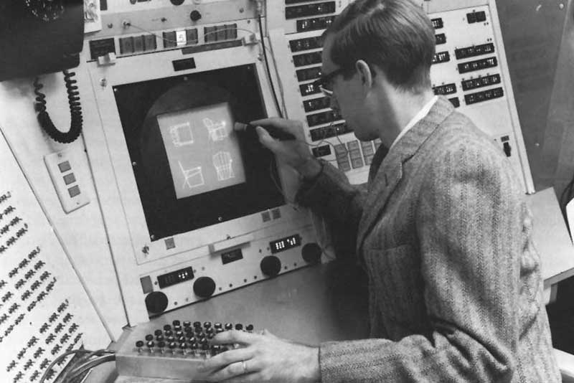
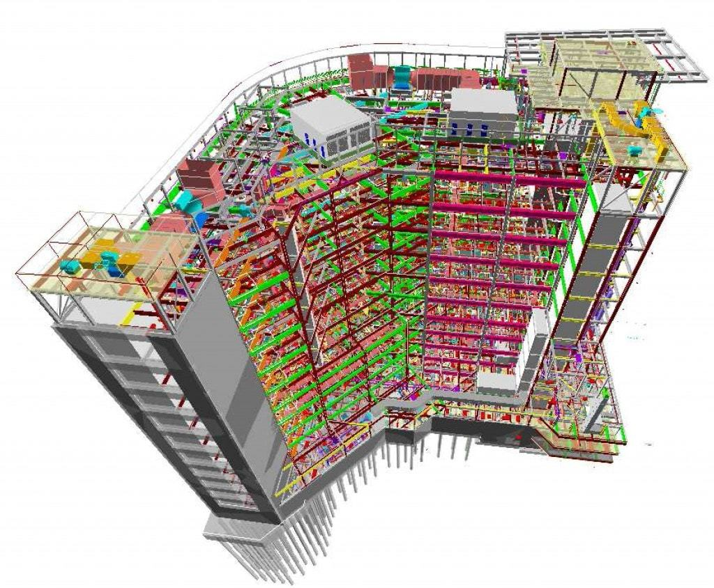
HOW THINGS ARE NOW DONE
CAD SOFTWARE
Computer Aided Design, or originally know as Computer Aided Drafting, are software designed to assist architects and designer to create and keep up with the growing complexity of projects. Originally starting in the 50s, CAD software are know wildly implemented across the industry.
GABRIEL

Slide 6
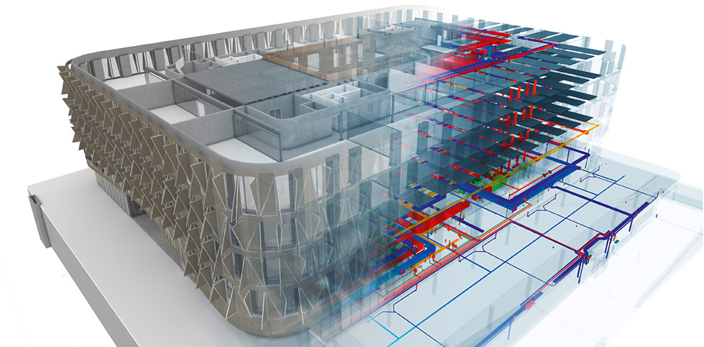
HOW THINGS ARE GOING TO BE DONE
THE FUTURE
CAD has expanded over the boundaries of just drafting, and as we moving towards the 21 century, CAD models are evolving into a more complex system of records and information, also knows as The Digital Twins and Building Information System (BIM).
Cities across the world are to create digital twins of their city to find optimal ways to build, transport and assist with the ongoing maintenance of infrastructure.
GABRIEL

Slide 7

THE END
CITATION & REFERENCE
Leo da Vinci Architect, Retrieved March 23, 2021
http://www.leonardo-da-vinci.net/
How CAD Has Evolved Since 1982, Retrieved March 22, 2021
https://www.scan2cad.com/cad/cad-evolved-since-1982/
GABRIEL

Slide 8
THANKS
GABRIEL

